Slide 1
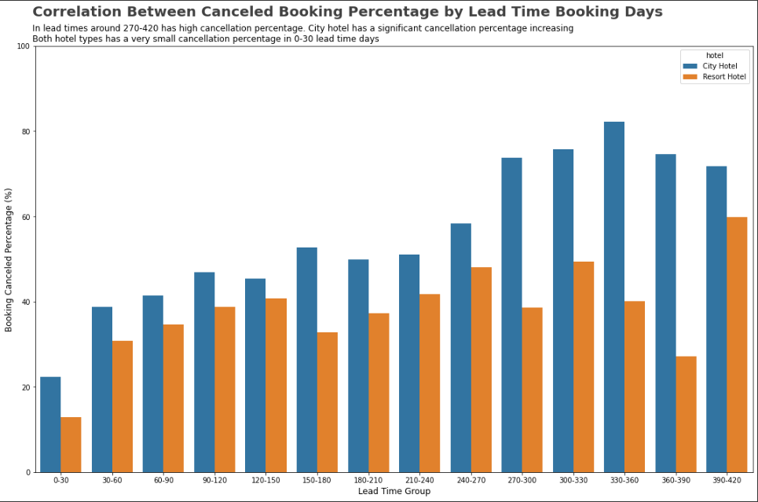
Impact Analysis of Lead Time on Hotel Bookings Cancellation Rate
Lead time have a positive correlation with cancellation percentage
As we can see in the graph, for city hotel, lead time group around 270-420 have a high cancellation percentage
Different with city hotel, resort hotel cancellation percentage decreasing in 300-390 days lead time and got a significant increase in 390-420 lead time
When the lead time is less than a month, the cancellation is very low in both hotel

